Slide 1
Rajiv Gandhi University Of Knowledge Technologies- Andhra pradesh
RK Valley Institute
(constituted under the A.p Govt .Act 18 of 2008 and recognized as per Section 2(f),12(B) of UGC Act,1956)
Accredited by ‘NAAC’ with ‘B+’ Grade
DEPARTIMENT OF COMPUTER SCIENCE AND ENGINEERING
PAYING GUEST ACCOMODATION FOR GLOBETROTTER
Under the guidance of
P Santhosh Kumar
S HEMALATHA(R190807)
1
Notes:
1

Slide 2
AGENDA
Abstract
Introduction
Literature Review
Motivation
Contribution
Modules
Module-1:System Requirements and Specification
Module-2:Front End Implementation
Module-3:Back End Implementation
Result and Discussion
Conclusion and Future Enhancement
References
2

Slide 3
ABSTRACT
In today's connected world, travelers seek affordable and comfortable places to stay that also offer cultural experiences.HOME HIVE provide a home-like environment, cost savings, and cultural exchange opportunities.
This project aims to create an easy-to-use platform connecting globetrotters with PG accommodations. Built with React.js for the frontend, Node.js for the server, and MongoDB for the database, the platform will feature a user-friendly web interface for hostsbook and list homes for PG stays.
It will include a detailed database with information on available PG options, such as location, amenities, and pricing, and a smart matching algorithm to suggest accommodations based on user preferences and travel plans.
.
2
3
Notes:
1

Slide 4
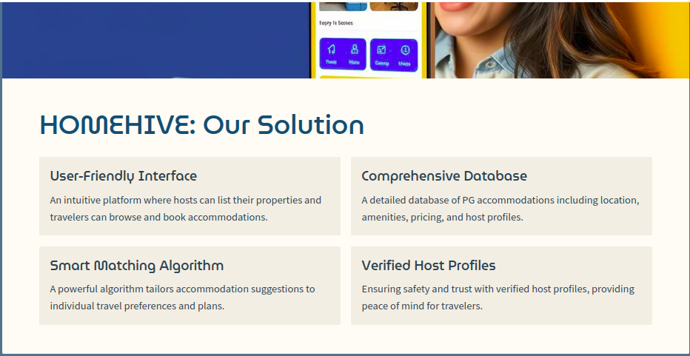
4

Slide 5
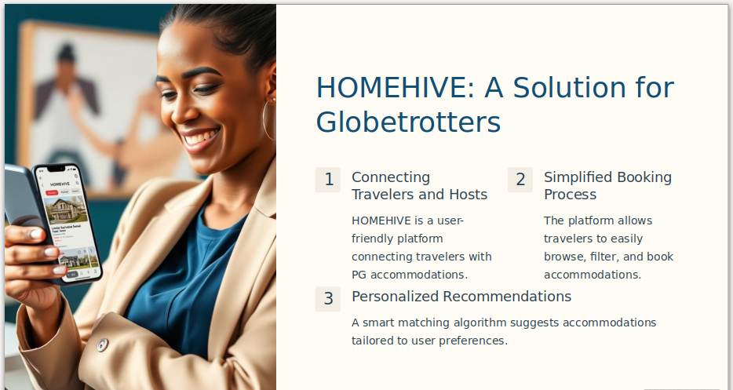
5
Notes:
1

Slide 6
Problem Statement
In the contemporary travel landscape, globetrotters seek affordable, culturally immersive accommodations that offer both comfort and authentic experiences. However, locating and booking paying guest (PG) accommodations is often inefficient and uncertain.
Existing platforms lack user-friendly interfaces, personalized recommendations, and adequate safety measures for host authenticity and transaction security.
This results in a disjointed experience for travelers and missed opportunities to meet the growing demand for culturally enriching travel experiences.
Recognizing these challenges, our project aims to develop a comprehensive solution using the MERN stack (MongoDB, Express.js, React.js, and Node.js). This platform will streamline booking processes, enhance information transparency about PG options, provide personalized accommodation suggestions, and incorporate robust verification mechanisms for host profiles.
5
6
Notes:
1

Slide 7
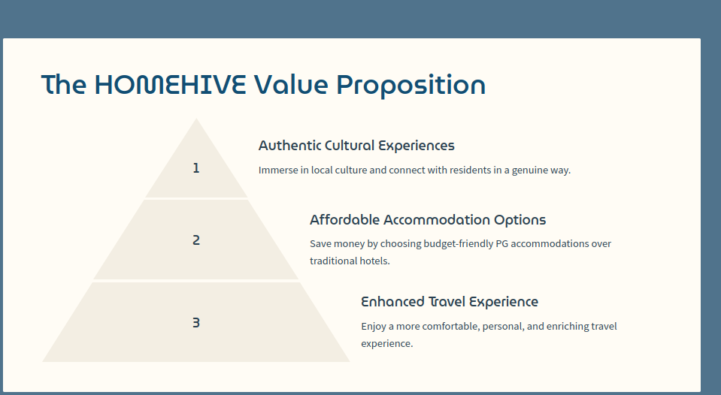
7

Slide 8
Literature Review
1. Thompson, A. (2019)
Method: Used HTML, CSS, and Bootstrap to create a responsive web interface for a PG accommodation platform.
Outcome: Developed a user-friendly design that adapts well to various screen sizes, significantly improving the user experience for travelers accessing the platform on different devices.
Drawback: The study noted limited interactivity and dynamic content handling, requiring additional scripting for a fully functional user experience.
2. Smith, J. (2020)
Method: Conducted surveys and interviews with globetrotters and hosts in major tourist cities.
Outcome: Identified key factors travelers consider when choosing PG accommodations, including cost, location, and cultural experience. This insight helps PG providers tailor their offerings to meet traveler preferences.
8

Slide 9
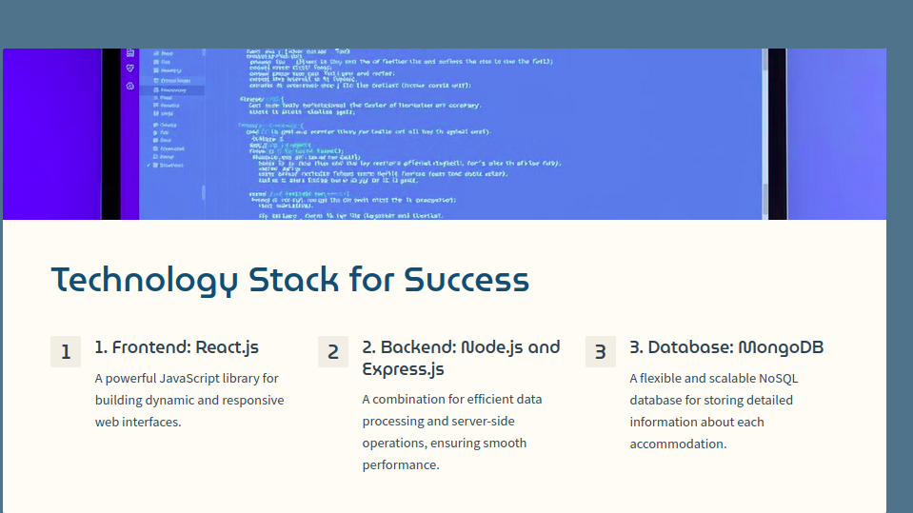
Objective of the Project
Develop a user-centric, technologically advanced platform using the MERN stack (MongoDB, Express.js, React.js, Node.js) to revolutionize the PG accommodation experience.
9
Notes:
1

Slide 10
Motivation
Motivated by travelers evolving needs for authentic cultural experiences, our project addresses fragmented information and safety concerns that deter travelers from choosing PG accommodations. We are developing a user-centric platform using the MERN stack (MongoDB, Express.js, React.js, Node.js) to provide a seamless interface for discovering, booking, and enjoying PG accommodations.
The platform will offer transparent details on PG locations, amenities, and pricing, ensuring travelers have all necessary information at their fingertips. Advanced algorithms will provide personalized recommendations based on individual preferences and travel plans, enhancing overall satisfaction and user experience.
10
Notes:
1

Slide 11
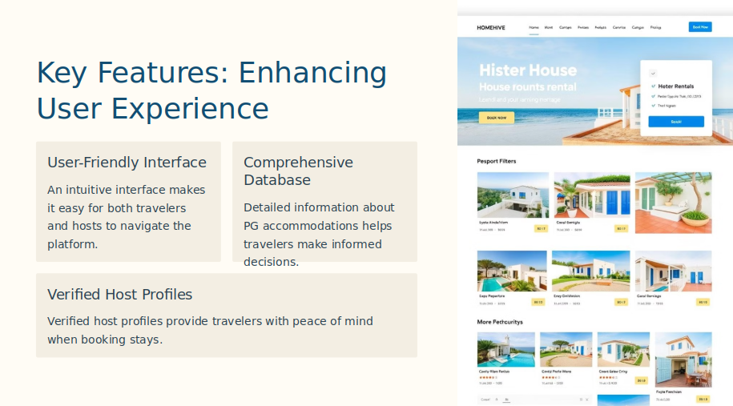
Contribution
11
Notes:
<number>

Slide 12
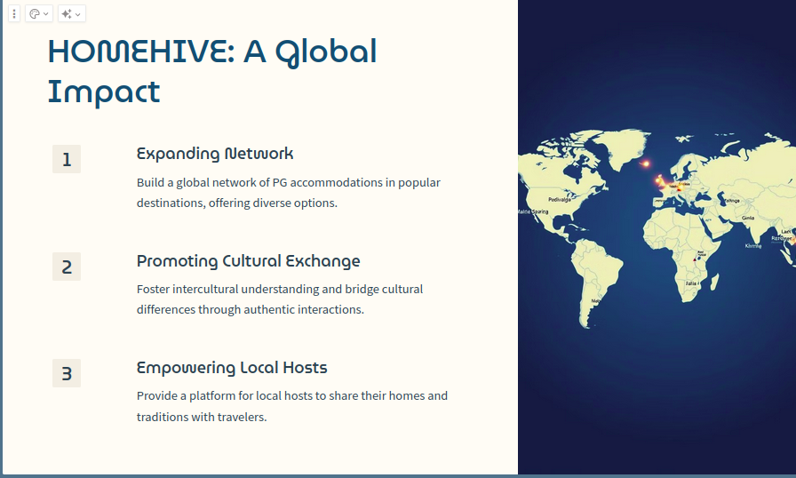
12

Slide 13
MODULES
Module-1:System Requirements and Specification
Technological Framework:
Utilizes the MERN stack (MongoDB, Express.js, React.js, Node.js) for high performance, scalability, and maintainability.
Developed within VS Code and operates on Windows 11.
Browser Compatibility:
Supports Internet Explorer and Google Chrome browsers to ensure broad user compatibility.
13

Slide 14
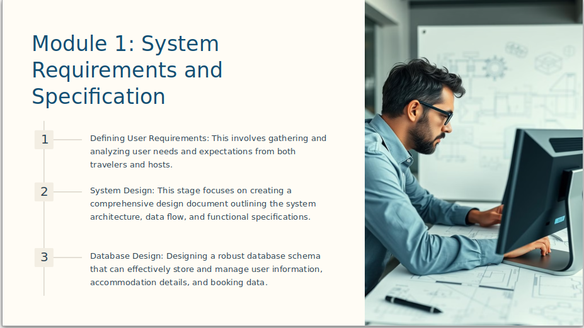
14

Slide 15
Hardware Requirements:
Processor: 1.0 GHz or greater.
RAM: 4GB or more.
Hard Disk: 1TB for smooth operation and extensive data storage.
Non Functional Requirements
Performance:
Responds to user interactions within 2 seconds under normal load conditions.Monitored through logging and performance metrics to identify bottlenecks.
15

Slide 16
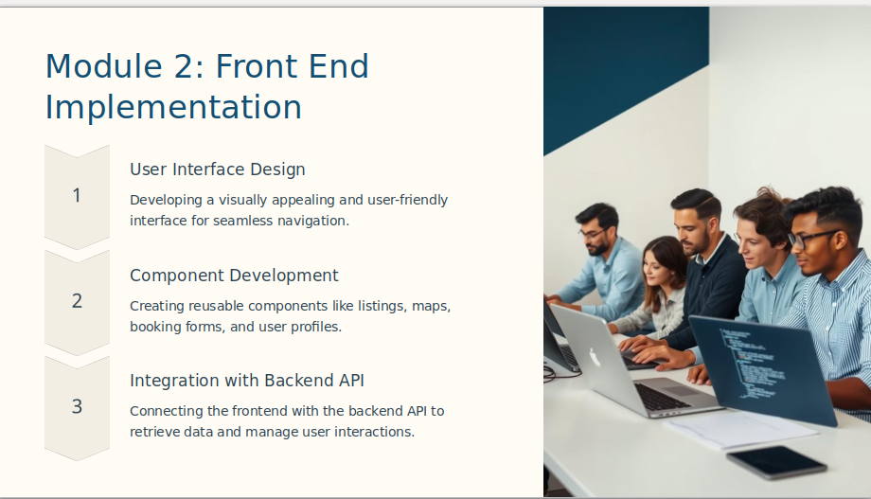
16

Slide 17
Client-Side Setup for React:
Dynamic and Responsive UI: Leverage React.js for a modern, user-friendly interface.
Reusable Components: Develop components for consistent and maintainable code.
Project Structure:
public/: Contains public assets and the main index.html file.
src/: Houses the source code for the React application.
assets/: Static assets like images, fonts, and icons.
components/: Reusable UI components (e.g., BookingForm).
pages/: Components representing different application views (e.g., Home, Accommodation List).
17

Slide 18
Packages Used:
@emotion/react: For writing CSS styles with JavaScript.
@emotion/styled: Styled-components library built for Emotion.
@mui/icons-material: Material-UI icons library.
@mui/material: Material-UI library for React components.
@reduxjs/toolkit: Tools for efficient Redux logic.
@testing-library/jest-dom: Custom Jest matchers for DOM state.
@testing-library/react: Library for testing React components.
@testing-library/user-event: Advanced browser interaction simulation for testing.
react: JavaScript library for building user interfaces.
react-beautiful-dnd: Drag-and-drop library for React.
react-date-range: Component for date range selection.
18

Slide 19
react-dom: Provides DOM-specific methods for React.
react-icons: Library for popular icons in React projects.
react-router-dom: Collection of navigational components.
redux: Predictable state container for JavaScript apps.
redux-persist: Saves the Redux store in persisted storage.
sass: Preprocessor scripting language interpreted or compiled into CSS.
web-vitals: Library for measuring important web performance metrics
Node_modules Directory:
Stores third-party libraries and modules.
Manages module dependencies for the project.
Simplifies managing and updating packages.
Ensures each project maintains its own dependencies.
19

Slide 20
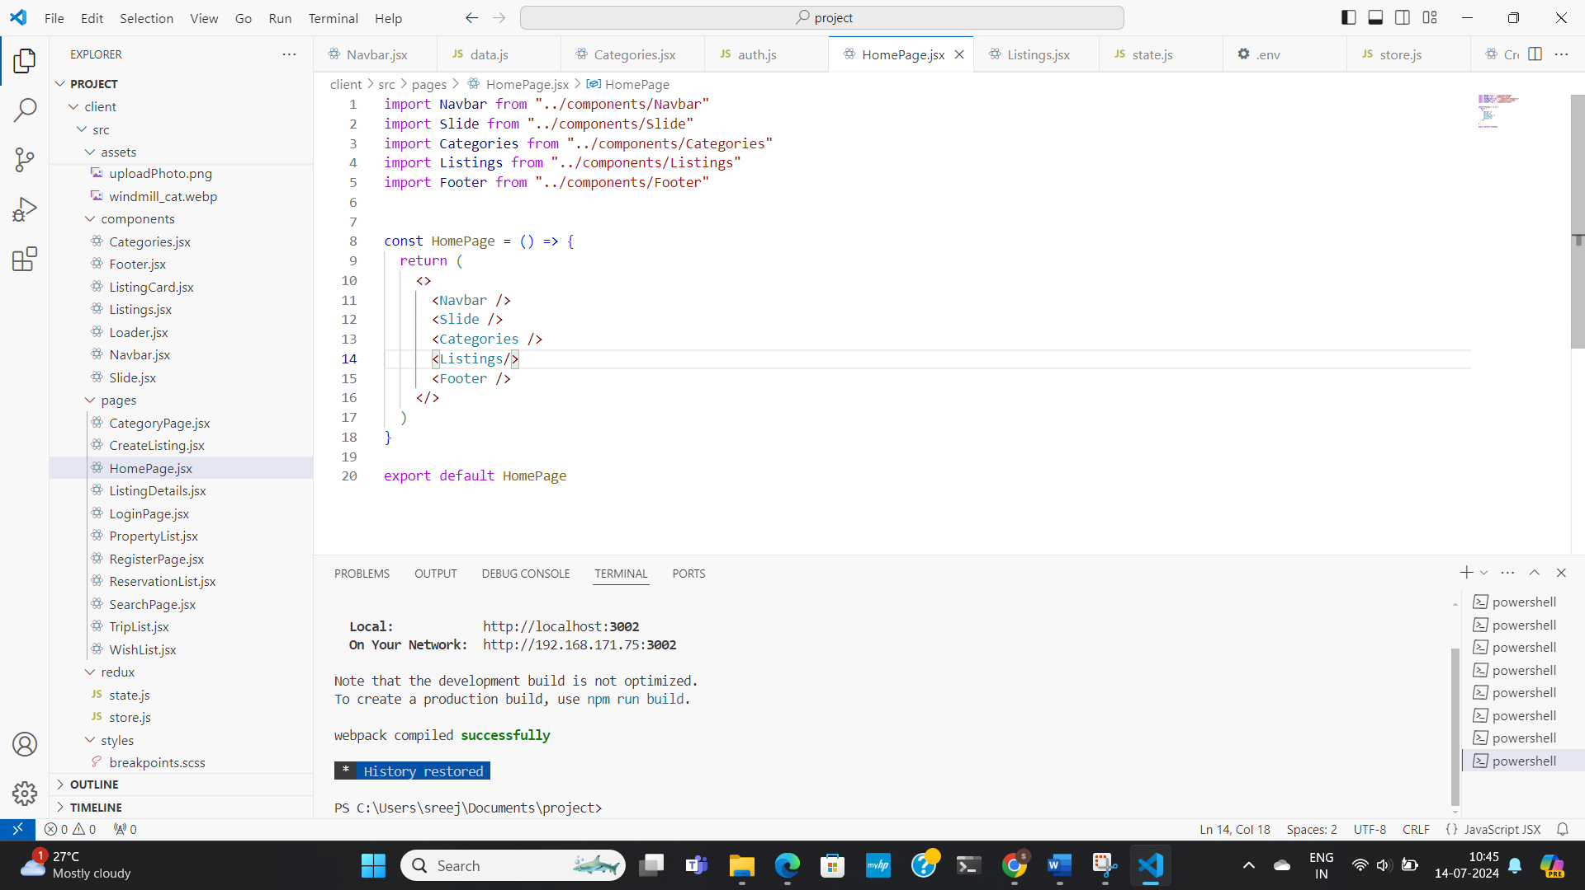
Supports development tools and build scripts.
Enhances application performance.
HomePage.jsx File:
20

Slide 21
The HomePage.jsx file is a key component of the front-end module for the Paying Guest Accommodations platform. This file sets up the structure for the home page by importing and assembling various components that make up the main interface seen by users. Below is an explanation of the components used in the HomePage.jsx file:
Navbar:
Provides navigation links.
Slide:
Displays a carousel of images or promotional content.
Categories:
Showcases different PG accommodation categories.
Listings:
Displays available PG accommodations.
.
21

Slide 22
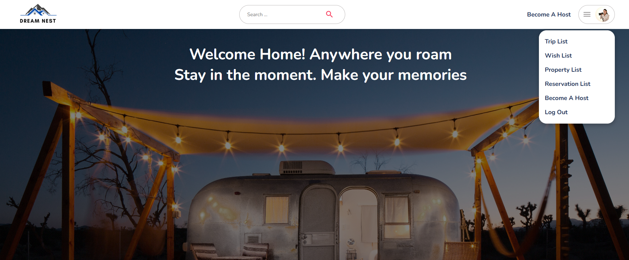
22

Slide 23
Registration Page (RegisterPage.jsx):
Import: Necessary hooks and functions from React and react-router-dom, and styles.
State Initialization: Manages form data and password matching status.
Handling Input Changes: Updates the state with user input.
Password Match Verification: Updates passwordMatch state.
Form Submission: Handles form submission, constructs FormData object, and handles registration logic
Sending the Form Data to the Server: Uses fetch API to send HTTP POST request to the server endpoint.
Handling the Server Response: Redirects to login page on success, logs error on failure.
23

Slide 24
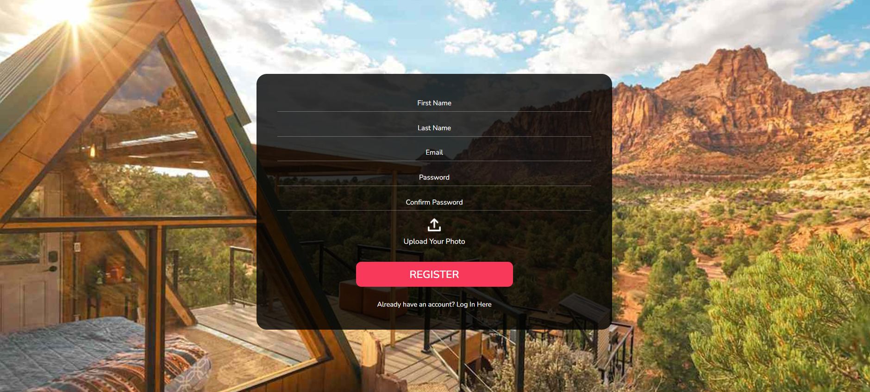
24

Slide 25
Module-3:Backend and Database Connection
Introduction:
The backend and database connection module of the "Paying Guest for Globetrotters" project manages data persistence, business logic, and client communication using Node.js, Express.js, and MongoDB.
Technology Stack:
Node.js: Efficiently handles asynchronous operations for scalable server-side applications.
Express.js: Simplifies routing, middleware integration, and request handling.
MongoDB: A schemaless, document-oriented database that aligns well with dynamic data structures.
18
25

Slide 26
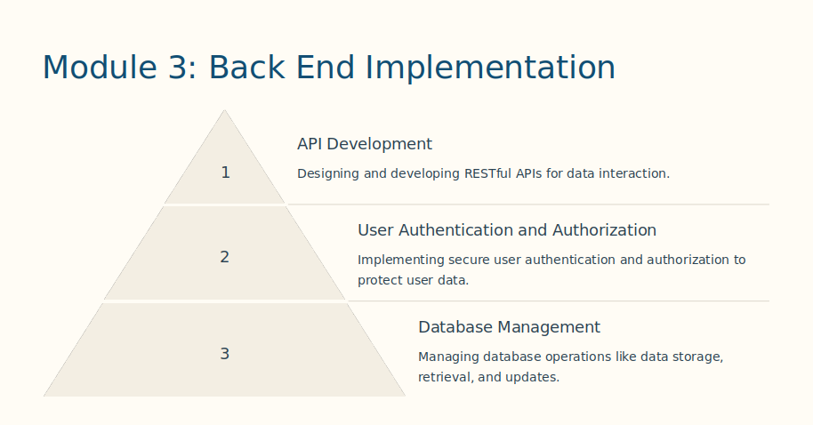
26

Slide 27
Project Structure:
Main Server File: Initializes the Express application, sets up database connections, and configures middleware.
Routes: Defines endpoints and API paths with Express Router, directing requests to appropriate controllers.
Models: Uses Mongoose schemas to represent data structure in MongoDB, handling data validation and access methods.
Implementation Details
Server Initialization: The index.js file serves as the main entry point, configuring middleware such as JSON parsing and error handling.
27

Slide 28
Database Connection: Connects to MongoDB using Mongoose, ensuring secure and efficient data storage and retrieval.
API Design: Follows RESTful principles, defining routes for operations such as listing accommodations, adding new accommodations, and managing bookings.
Middleware: Implements middleware for authentication (if applicable), input validation, and error handling to enhance API robustness and security.
Index.js
Imports and Setup: We've imported necessary modules such as express, mongoose, dotenv, and cors. We've initialized express() to create your application (app).
28

Slide 29
Middleware: we’ve configured middleware:
cors() to handle Cross-Origin Resource Sharing.
express.json() to parse JSON bodies of incoming requests.
express.static("public") to serve static files from the "public" directory.
Routes: we've defined routes for different functionalities (auth, properties, bookings, users) using app.use() and corresponding route files (authRoutes, listingRoutes, bookingRoutes, userRoutes).
MongoDB Connection: We've connected to MongoDB using mongoose.connect():
To start server, ensure that set up the process.env.MONGO_URL variable with our MongoDB connection string, including necessary options like useNewUrlParser and useUnifiedTopology for compatibility and monitoring. Once configured, launch server by calling app.listen(PORT), where PORT is set to 3001. This command starts server, allowing it to handle incoming requests on the specified port effectively.
29

Slide 30

30

Slide 31
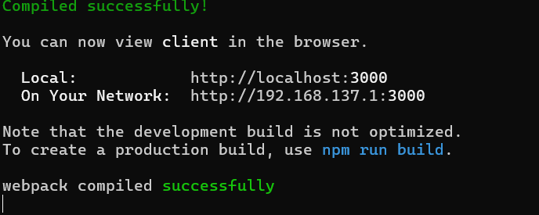
RESULTS AND DISCUSSIONS
FIGURE 4.1: Client Connection Success
31

Slide 32
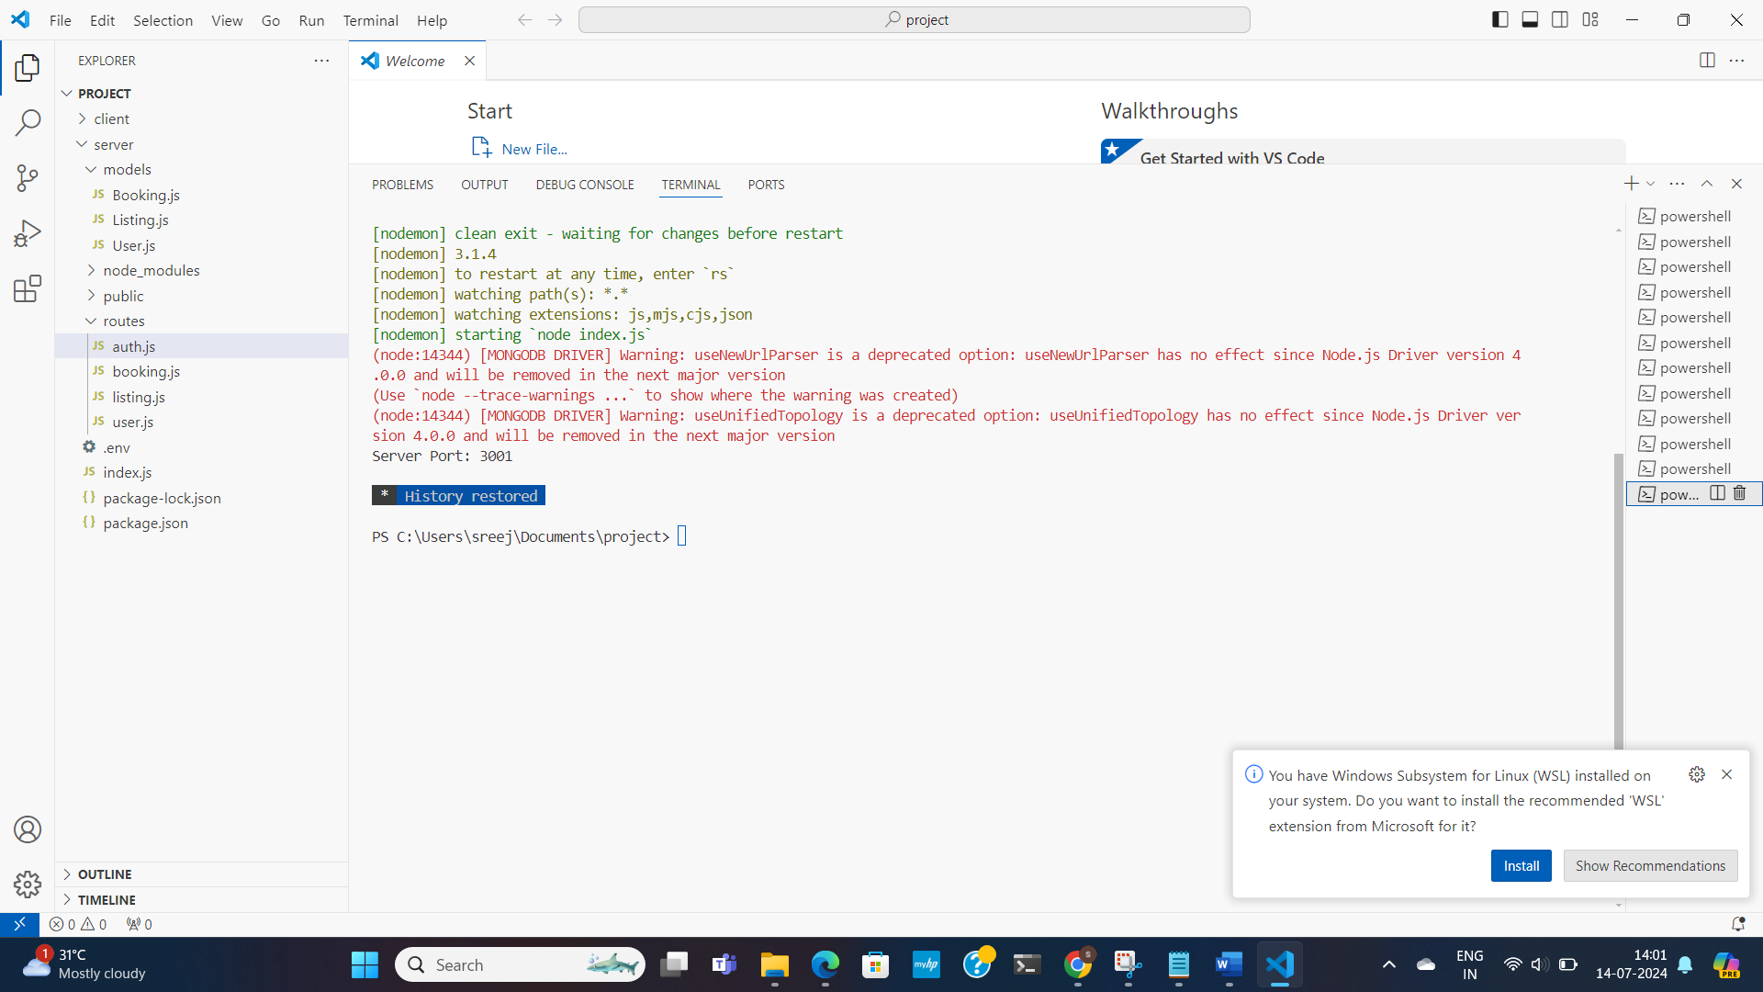
SERVER SIDE CONNECTION
In our project, setting up a server connection was pivotal for enabling communication between our React frontend and backend server. Using Node.js with Express, we established our backend infrastructure, configuring it to listen on Port 3000.
32

Slide 33
Conclusion and Future Enhacement
Conclusion:
In concluding my project, on the frontend, we've prioritized creating an engaging and intuitive user interface (UI) using React.js.UI design emphasizes intuitive navigation, visually appealing elements, and clear interactions to enhance usability and encourage deeper user engagement with our application. Leveraging React.js, we've ensured that our UI is responsive and dynamic, providing a seamless experience for users.
33

Slide 34
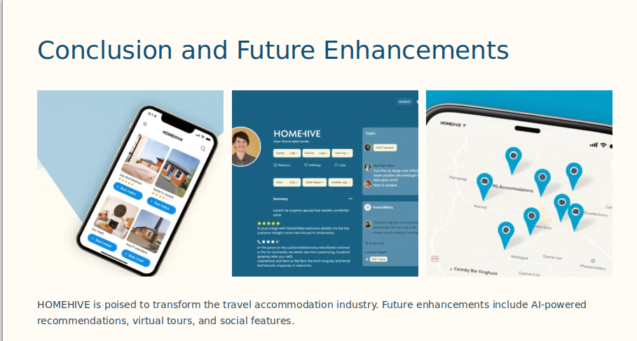
34

Slide 35
REFERENCES:
1) React Documentation: React - A JavaScript library for building user interfaces. Available at Getting Started – React (reactjs.org).
2) Bootstrap Documentation: Bootstrap - The world’s most popular framework for building responsive, mobile-first sites. Available at: ReactBootstrap | React Bootstrap (react-bootstrap.github.io)
3) Node.js Documentation: Node.js - JavaScript runtime built on Chrome's V8 JavaScript engine. Available at: Node.js v22.4.1 Documentation (nodejs.org)
4) MongoDB Documentation: MongoDB - A NoSQL database for modern applications. Available at: Introduction to MongoDB - MongoDB Manual v7.0.
35

